Slide 1
NDW RX EXTRACT Advanced Analytics
RX Raw Claim Level Extract
May. 2017

Slide 2
Overview
Data
Sample Email to Apply Schema
Connect to Oracle.
RX Claim Level Extract Standard Procedure
Caveats
Notes:
文档详细说明；
重要的部分；
分享常见问题， 解决办法

Slide 3
Most frequently used columns
CLAIM_ID
SVC_DT
DAYS_SUPPLY_CNT
FILL_NBR(0 for Nrx, >0 for Rrx)
PATIENT_ID
MONTH_ID
PRODUCT_ID
PROVIDER_ID (V_PROVIDER@NDW to link PRI_SPCL_CD)
PHARMACY_ID
CHNL_CD
Notes:
Claim_id unique
Fill number 0– original fill, >0 refill
Provider_id to link reference table v_provider@ndw to know the provider information
Usually use pri_spcl_cd, primary specialty code ‘’IM”(INTERNAL MEDICINE) “POD”(PODIATRIST)
Chnl_cd M mailorder
S specialty mail
L long term care
R retail

Slide 4
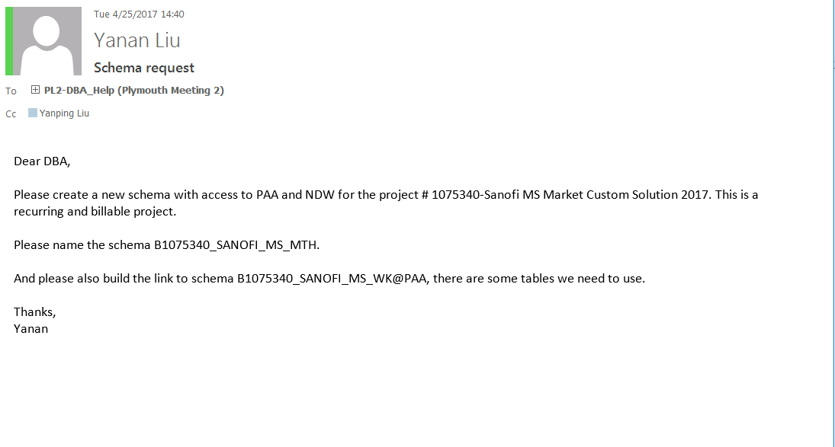
Email Sample

Slide 5
Procedure
RX Claim Level Extract will extract data from v_rx_fact_hdr_frw.
Notes:
文档详细说明；
重要的部分；
分享常见问题， 解决办法

Slide 6
Initial Setting
--INITIAL PROCESS ON NDW
CALL DBMS_SESSION.RESET_PACKAGE();
--tab=Enable Output
CALL DBMS_OUTPUT.ENABLE(10000000);
--tab=Setup AA standards
CALL I35144_STD.std_utils.P_INIT_STANDARDS();
--tab=Setup Log
CALL std_log.P_SETUP();
Notes:
文档详细说明；
重要的部分；
分享常见问题， 解决办法

Slide 7
Parameter
Parameter Name | Description | Optional
pv_req_nm | Name of request | No
pv_cre_nm | Requestor name. | No
pv_cre_email_addr | Requestor email address. Separated by “;” if more than one specified. | No
pv_callg_appl_req_id | Calling application request ID. | Yes for Ad-Hoc initial request. For ongoing request, has to enter the initial request ID.
pv_req_typ | I for Initial data pull request, M for ongoing monthly request, W for weekly recurring request. | No for Ad-Hoc.
pv_strt_mth_wk | First month/week ID of the data pull. | No
pv_end_mth_wk | Last month/week ID of the data pull. | No

Slide 8
Parameter
Parameter Name | Description | Optional
pv_ref_tbl | Product reference table must exist in the calling schema, and has the column product_id | No
pv_chnl | Limit data pull to certain channel(s). Could be M, R, L, A and S | Yes
pv_pat_tbl | Patient list to limit the data pull. | Yes
pv_provider_tbl | Provider list to limit the data pull. | Yes
pv_clmn_list | Comma separated column list. It could be any column from RX Header or product reference table or columns from v_provider. | Yes
pv_obj_nm_out | output table name, example FRW_RXCLM_REQ21924, Defined as a character variable in pl/sql | No

Slide 9
Sample Call -- Initial
DECLARE
v_tbl_nm varchar2(100);
BEGIN
frw_process_pkg. PR_RX_CLAIM_LVL_DP
(
pv_req_nm =>‘RX monthly'
,pv_req_desc =>'data pull'
, pv_cre_nm =>'YNLIU'
, pv_cre_email_addr =>'ynliu@cn.IMSHEALTH.COM'
-- , pv_callg_appl_req_id =>27812 --needed for PRS requests or Monthly data extract
, pv_callg_appl_nm => 'MANUAL'
, pv_req_typ =>‘I'
, pv_strt_mth_wk =>201703
, pv_end_mth_wk => 201703
, pv_ref_tbl =>'ARISTADA_DOI'
, pv_pat_tbl => ''
, pv_clmn_list =>
'CLAIM_ID,SVC_DT, FILL_NBR, DAYS_SUPPLY_CNT, PATIENT_ID,MONTH_ID, PRODUCT_ID,NDC,
PHARMACY_ID, PROVIDER_ID, CHNL_CD,
MKTED_PROD_NM,STRNT_VALUE_NBR'
,pv_obj_nm_out => v_tbl_nm
);
END;
DECLARE
v_tbl_nm varchar2(100);
BEGIN
frw_process_pkg.PR_MHA_CLAIM_LVL_DP
(
pv_req_nm =>'MHA raw data'
,pv_req_desc =>'data pull'
,pv_cre_nm =>'YNLIU'
,pv_cre_email_addr =>'ynliu@cn.IMSHEALTH.COM'
--,pv_callg_appl_req_id =>27811 --needed for PRS requests or Monthly data extract
,pv_callg_appl_nm => 'MANUAL'
,pv_req_typ =>'M'
,pv_strt_mth_wk =>201703
,pv_end_mth_wk =>201703
,pv_ref_tbl =>'ARISTADA_DOI'
,pv_pat_tbl => ''
,pv_clmn_list =>
'CLAIM_ID,SVC_DT, FILL_NBR, DAYS_SUPPLY_CNT, PATIENT_ID,MONTH_ID, PRODUCT_ID,NDC,
AUTH_RFLL_NBR,PHARMACY_ID,IMS_PAYER_ID,PROVIDER_ID, INGRD_COST_PAID_AMT, DSPNSD_QTY, RX_NBR,
PRI_SPCL_CD,FACILITY_ID,FACILITY_TYPE,PRI_PAYER_TYP_CD,SEC_PAYER_TYP_CD,TER_PAYER_TYP_CD,
MKTED_PROD_NM,STRNT_VALUE_NBR'
,pv_obj_nm_out =>v_tbl_nm
);
END;

Slide 10
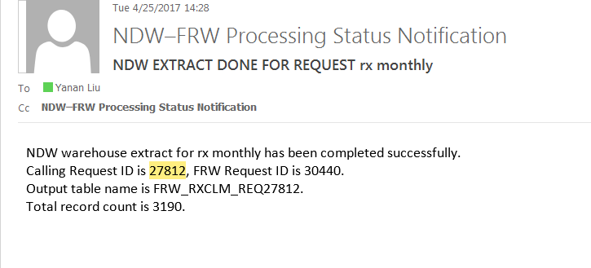
Sample Call - initial

Slide 11
Sample Call -- Recurrent
DECLARE
v_tbl_nm varchar2(100);
BEGIN
frw_process_pkg. PR_RX_CLAIM_LVL_DP
(
pv_req_nm =>‘RX monthly'
,pv_req_desc =>'data pull'
, pv_cre_nm =>'YNLIU'
, pv_cre_email_addr =>'ynliu@cn.IMSHEALTH.COM'
, pv_callg_appl_req_id =>27812
, pv_callg_appl_nm => 'MANUAL'
, pv_req_typ =>‘M'
, pv_strt_mth_wk =>201703
, pv_end_mth_wk => 201703
, pv_ref_tbl =>'ARISTADA_DOI'
, pv_pat_tbl => ''
, pv_clmn_list =>
'CLAIM_ID,SVC_DT, FILL_NBR, DAYS_SUPPLY_CNT, PATIENT_ID,MONTH_ID, PRODUCT_ID,NDC,
PHARMACY_ID, PROVIDER_ID, CHNL_CD,
MKTED_PROD_NM,STRNT_VALUE_NBR'
,pv_obj_nm_out => v_tbl_nm
);
END;
DECLARE
v_tbl_nm varchar2(100);
BEGIN
frw_process_pkg.PR_MHA_CLAIM_LVL_DP
(
pv_req_nm =>'MHA raw data'
,pv_req_desc =>'data pull'
,pv_cre_nm =>'YNLIU'
,pv_cre_email_addr =>'ynliu@cn.IMSHEALTH.COM'
--,pv_callg_appl_req_id =>27811 --needed for PRS requests or Monthly data extract
,pv_callg_appl_nm => 'MANUAL'
,pv_req_typ =>'M'
,pv_strt_mth_wk =>201703
,pv_end_mth_wk =>201703
,pv_ref_tbl =>'ARISTADA_DOI'
,pv_pat_tbl => ''
,pv_clmn_list =>
'CLAIM_ID,SVC_DT, FILL_NBR, DAYS_SUPPLY_CNT, PATIENT_ID,MONTH_ID, PRODUCT_ID,NDC,
AUTH_RFLL_NBR,PHARMACY_ID,IMS_PAYER_ID,PROVIDER_ID, INGRD_COST_PAID_AMT, DSPNSD_QTY, RX_NBR,
PRI_SPCL_CD,FACILITY_ID,FACILITY_TYPE,PRI_PAYER_TYP_CD,SEC_PAYER_TYP_CD,TER_PAYER_TYP_CD,
MKTED_PROD_NM,STRNT_VALUE_NBR'
,pv_obj_nm_out =>v_tbl_nm
);
END;

Slide 12
LTC Channel Data
Confirm with the methodologist if RX or MHA source is needed
RX source LTC:
call PR_RX_CLAIM_LVL_DP
pv_chnl => 'L'
MHA source LTC:
call PR_MHA_CLAIM_LVL_DP

Slide 13
Questions/Comments?

